Slide 1

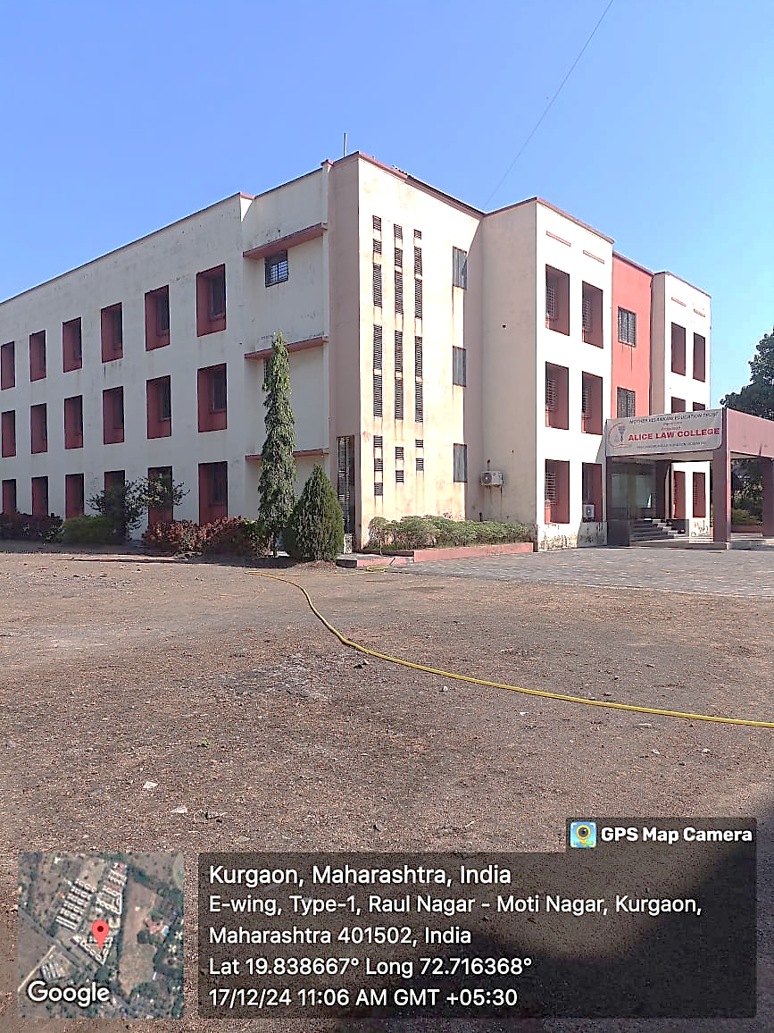
Alice Law College
(LLB 3Year & 5 Year Programme)
Raul Nagar, Kurgaon, Boisar West - 401501
Excellence in Legal Education Since Establishment

Slide 2

About Alice Law College
Strategic Location
Situated at Raul Nagar, Kurgaon, Boisar West, 401501, providing easy accessibility for students across the region.
Quality Education
Committed to delivering exceptional legal education with state-of-the-art infrastructure and modern teaching methodologies.
Holistic Development
Focus extends beyond academics to include ethics, discipline, and character building for well-rounded legal professionals.
Expert Faculty
Experienced and dedicated faculty members committed to nurturing future legal minds and ensuring student success.

Slide 3
ABOUT MANAGEMENT

Slide 4

MRS. ASHA MATHEW DSOUZA- CHAIRPERSON
To know about Asha madam, it gives me pleasure to tell you all, that she is a very dynamic lady, having highly set goals and a great vision to impart education in the society. With this aim she took the responsibility on her shoulders to establish these institutes. Today education is perhaps, the most important factor determining a country’s overall progress. It then becomes important to question, whether chalked out policies are actually being implemented? An important amendment in the field of education is the 83rd constitutional amendment. This declares elementary education as a fundamental right of all Indian citizens. The 93rd amendment of 2006 is another suitable example. This policy provides for greater access to higher education including professional education to students belonging to members of SC, ST and OBC’s.
Our aim is extend our institutional to international levels and standards to reach out global; providing all possible opportunities to our students based over our objectives specially focused on ‘KASSM’ i.e. imparting knowledge and attitude with development of skills, social and moral values to be better human being with quality and caliber.

Slide 5
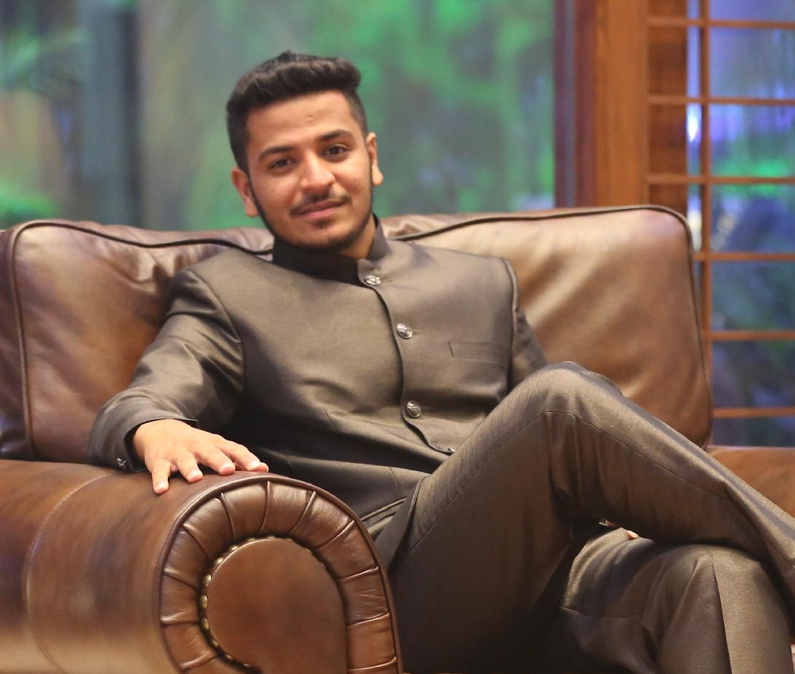
MR. DEEP GABRIEL MURZELLO- VICE-CHAIRPERSON
We take this opportunity to introduce you to Mr. Deep Gabriel Murzello.
He is a true standout in the field of education. Mr. Deep holds an MBA degree in International Business and has completed his Bachelor of Legislative Law (LL.B.) from the University of Mumbai. He has diverse experience in the field of logistics and supply chain management at Vulkan Industries, Pune, and has also worked with the Mediterranean Shipping Company. Besides his professional achievements, Mr. Deep has maintained an excellent academic record and has made a remarkable mark in extracurricular activities. He shares a visionary approach towards student development and is dedicated to helping Alice Law College reach the pinnacle of success. Currently, he is pursuing his Ph.D. in the field of Education.

Slide 6

Dr. Rivi Rebello- Secretary
We take this opportunity to introduce you to Mrs. Rivi Rebello, the Secretary of Alice Law College.
Dr. Rivi Rebello is a distinguished professional who has completed her dental studies in the United Kingdom. With her international academic background and exposure to global professional standards, she brings valuable insights and a progressive outlook to the institution. She is currently practicing in the UK and continues to contribute to the development and strategic growth of Alice Law College through her vision, dedication, and leadership.

Slide 7
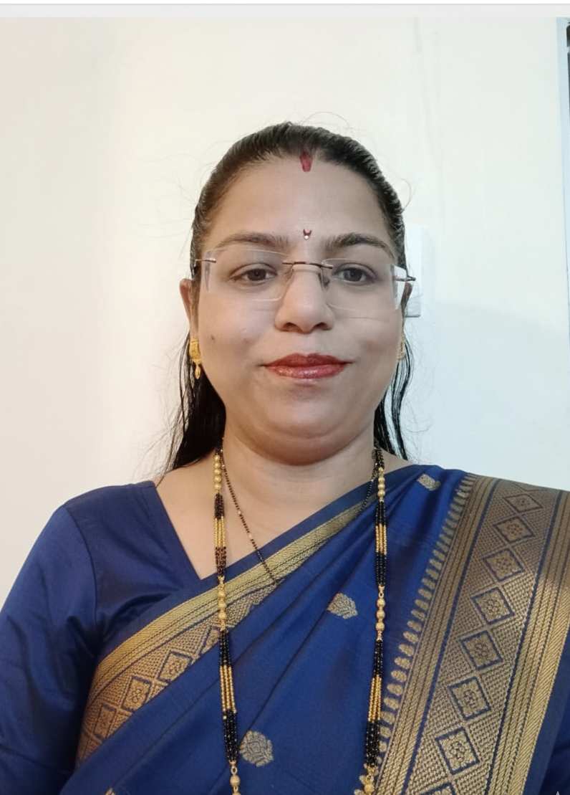
Dr. Shweta Chaudhary – Principal
We take this opportunity to introduce you to Dr. Shweta Chaudhary, the Principal of Alice Law College.
Dr. Shweta Chaudhary is an accomplished academician and a dedicated educationist with qualifications in LL.B., LL.M., and a Ph.D. specializing in Child Labour. Her deep understanding of legal education and her commitment to student development have been instrumental in shaping the academic excellence of the institution. With her leadership and vision, Alice Law College continues to inspire and nurture future legal professionals committed to justice and social responsibility.

Slide 8

Academic Attendance & Schedule Requirements
Mandatory Attendance
Minimum 75% attendance required to qualify for semester examinations - no exceptions granted.
Class Schedule
Monday to Saturday, 8:30 AM to 3:00 PM, ensuring comprehensive coverage of curriculum.
Academic Calendar
Strict adherence to semester schedules and examination norms as per university regulations.
Medical Absences
Students must inform college authorities with proper medical certificates for justified absences.

Slide 9

Code of Conduct Guidelines
Electronic Device Policy
Mobile phones and electronic gadgets strictly prohibited during lectures to maintain academic focus and respect.
Substance-Free Campus
Complete ban on tobacco, alcohol, and drugs throughout campus premises - zero tolerance policy enforced.
Respectful Behaviour
Courteous and respectful conduct expected towards faculty members, staff, and fellow students at all times.
Disciplinary Consequences
Violations result in appropriate disciplinary actions including fines, suspension, or expulsion based on severity.

Slide 10





Campus Facilities & Student Responsibilities
Library Access
Campus Environment
Well-equipped library open 8:30 AM to 4:30 PM daily, featuring extensive legal resources and dedicated internet section for research.
Clean, green campus maintained through strict no-eating policy in study areas and collective responsibility for cleanliness.
Identification Protocol
Resource Management
Students must carry and prominently display ID cards at all times for security and identification purposes.
Responsible usage of college resources and internet facilities mandatory - misuse subject to disciplinary action.

Slide 11
Disciplinary Framework & Penalties
Recording Restrictions
Unauthorised recording of lectures, conversations, or college activities strictly prohibited without explicit permission from authorities.
Cyber Law Compliance
Internet misuse or downloading unauthorised content punishable under applicable Cyber Laws with serious legal consequences.
Academic Discipline
Loitering during scheduled class hours and privacy violations result in immediate penalties and corrective measures.
Clearance Requirements
Students must obtain official "No Dues Certificate" before leaving college to ensure all obligations are fulfilled.

Slide 12





World-Class Infrastructure
Well Equipped Classrooms
Modern learning spaces equipped with interactive smart boards and comprehensive audio-visual aids for enhanced legal education.
Moot Court Hall
Spacious, professionally designed moot court facility providing authentic courtroom experience for practical advocacy training
Comprehensive Library
Extensive law library featuring both digital databases and physical resources, supporting research and academic excellence
Digital Facilities
Student common areas and computer labs with high-speed internet connectivity
for modern legal research and study

Slide 13

The 5-Year LLB Course Overview
Comprehensive Programme
Integrated undergraduate law degree spanning 10 semesters
Curriculum designed as per University of Mumbai guidelines
Combines foundational arts subjects with core legal studies
Prepares students for legal practice, judiciary, and academic careers
This programme provides a thorough grounding in legal principles whilst developing critical thinking and analytical skills essential for the legal profession.

Slide 14




Curriculum Highlights
Semester System
Core Subjects
Each semester carries 500 marks with comprehensive evaluation methods ensuring thorough understanding of legal concepts.
Constitutional Law, Criminal Law, Contract Law, Property Law, and other essential legal disciplines forming the foundation of legal education.
Practical Training
Assessment Methods
Emphasis on moot courts, internships, and legal aid clinics to bridge theoretical knowledge with real-world application.
Continuous evaluation through assignments, presentations, and examinations ensuring comprehensive skill development.

Slide 15
LLB 5-Year Course Structure
Our comprehensive programme spans 10 semesters, each carrying 500 marks, designed to progressively
build legal knowledge and practical skills.
Year 1: Foundation
1
Legal Language, Constitutional Law, Law of Contract
2
Year 2: Core Development
Criminal Law, Family Law, Environmental Law
Year 3: Specialisation
3
Property Law, Administrative Law, Intellectual Property
4
Year 4: Advanced Practice
Alternative Dispute Resolution, Legal Research
Year 5: Professional Readiness
5
Professional Ethics, Drafting, Moot Court Excellence

Slide 16

Comprehensive Subject Portfolio
Core Legal Subjects
Specialised Areas
Professional Skills
Constitutional Law
Environmental Law
Legal Ethics
Contract Law
Property Law
Alternative Dispute Resolution
Criminal Law
Administrative Law
Legal Drafting
Family Law
Intellectual Property Rights
Professional Responsibility

Slide 17

Detailed Syllabus Features
Comprehensive Coverage
Each subject encompasses foundational principles, landmark case laws, and contemporary legal issues, ensuring students develop a thorough understanding of both theory and practice.
Global Perspective
Integration of Indian and international legal perspectives provides students with a broader understanding of legal systems and comparative jurisprudence.
Practical Components
Case studies and analysis
Drafting exercises
Research projects
Contemporary legal developments

Slide 18



Marking Scheme & Evaluation
75%
25%
40%
Theory Examinations
Internal Assessment
Minimum Pass Grade
Comprehensive written assessments testing conceptual understanding
Assignments, presentations, and moot court performances
Required percentage for successful completion of each subject
Our continuous evaluation system encourages consistent performance throughout the semester, with each semester carrying a total of 500 marks distributed across various assessment methods.

Slide 19
Examination Pattern
01
02
Written Examinations
Question Format
Semester-end examinations conducted under strict university guidelines with comprehensive question papers
Balanced mix of objective questions, short answers, and detailed long-form responses
03
04
Practical Assessments
Academic Integrity
Moot court performances, viva voce examinations, and project submissions
Strict adherence to examination protocols ensuring fair and transparent evaluation

Slide 20

LLB 3-Year Programme Details
Programe Duration
1
3 years divided into 6 comprehensive semesters, ensuring thorough understanding of legal principles and practices.
University Affiliation
2
Affiliated with the prestigious University of Mumbai, ensuring recognised qualifications and academic excellence.
3
Eligibility Criteria
Graduation with minimum 45% marks plus MH-CET qualification required for admission consideration.
4
Annual Intake
240 students per academic year, maintaining optimal student-faculty ratios for personalised attention.
Important: All admissions are subject to MH-CET merit list and university guidelines.

Slide 21

LL.B. 3 Years Programme Overview
Programe Structure
Duration: 3 academic years, systematically divided into 6 comprehensive semesters
Learning Approach: Strategic combination of theoretical knowledge, practical applications, and real-world internships
Core Focus: Building strong legal knowledge foundation, professional ethics, and essential advocacy skills for successful legal practice

Slide 22
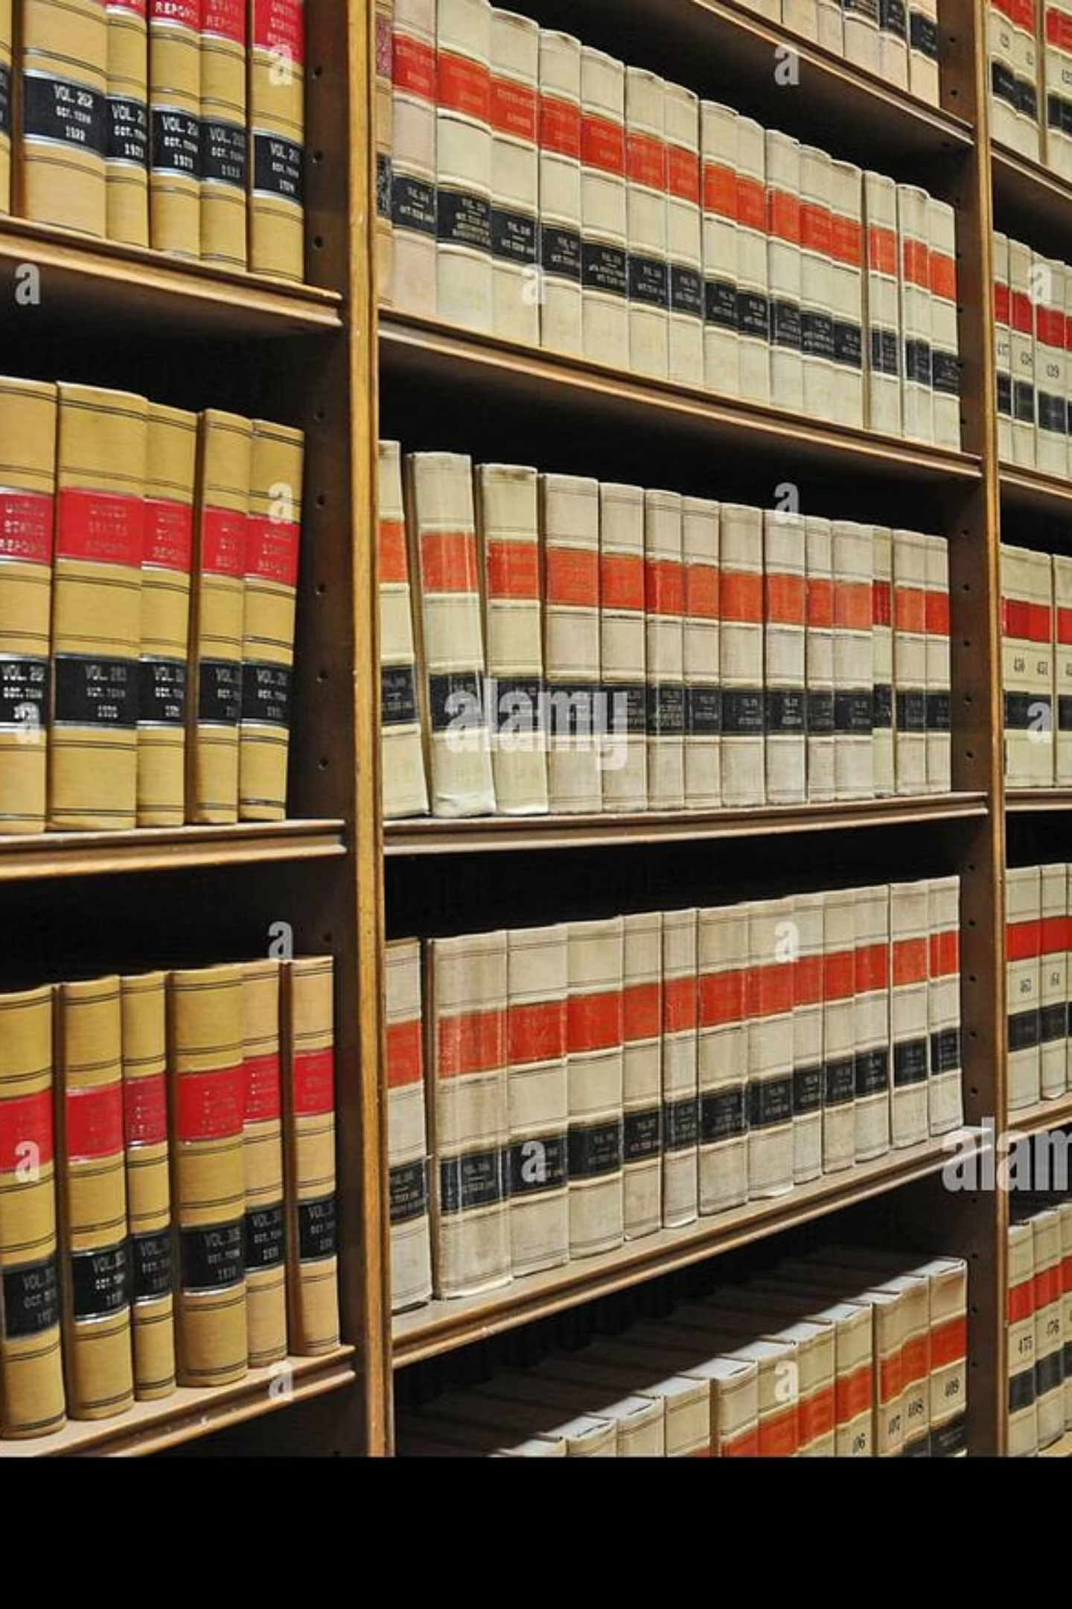




Comprehensive Course Structure
Core Legal Subjects
Constitutional Law, Criminal Law, Contract Law, Tort Law, Family Law, and other fundamental areas of legal practice.
Practical Training
Hands-on experience through moot courts, internships, and legal aid camps to bridge theory and practice.
Updated Curriculum
Syllabus reflecting recent legal developments including 2024 amendments to keep students current with evolving law.
Flexible Options
LL.B. (General) available after 2 years for students not intending to practice law professionally.

Slide 23

Year 2: Specialisation Begins
Semesters 3 & 4
Core Subjects
Jurisprudence - Legal theory and philosophy
Labour Law I & II - Employment and industrial relations
Property Law - Real estate and ownership rights
Criminal Procedure Code & Juvenile Justice Act
Administrative Law - Government powers and judicial review
Public International Law - Global legal frameworks
Optional Specialisations
Insurance Law
Banking Law
Right to Information Act

Slide 24

Examination Pattern
Semester System
Examinations conducted at the end of each semester during May and December sessions
Theory Papers
100 marks each with 3-hour duration for comprehensive
assessment
Practical Assessment
Written component: 75 marksViva/Practical: 25 marks
Continuous Evaluation
Internal assessments through assignments, presentations, and regular academic participation

Slide 25
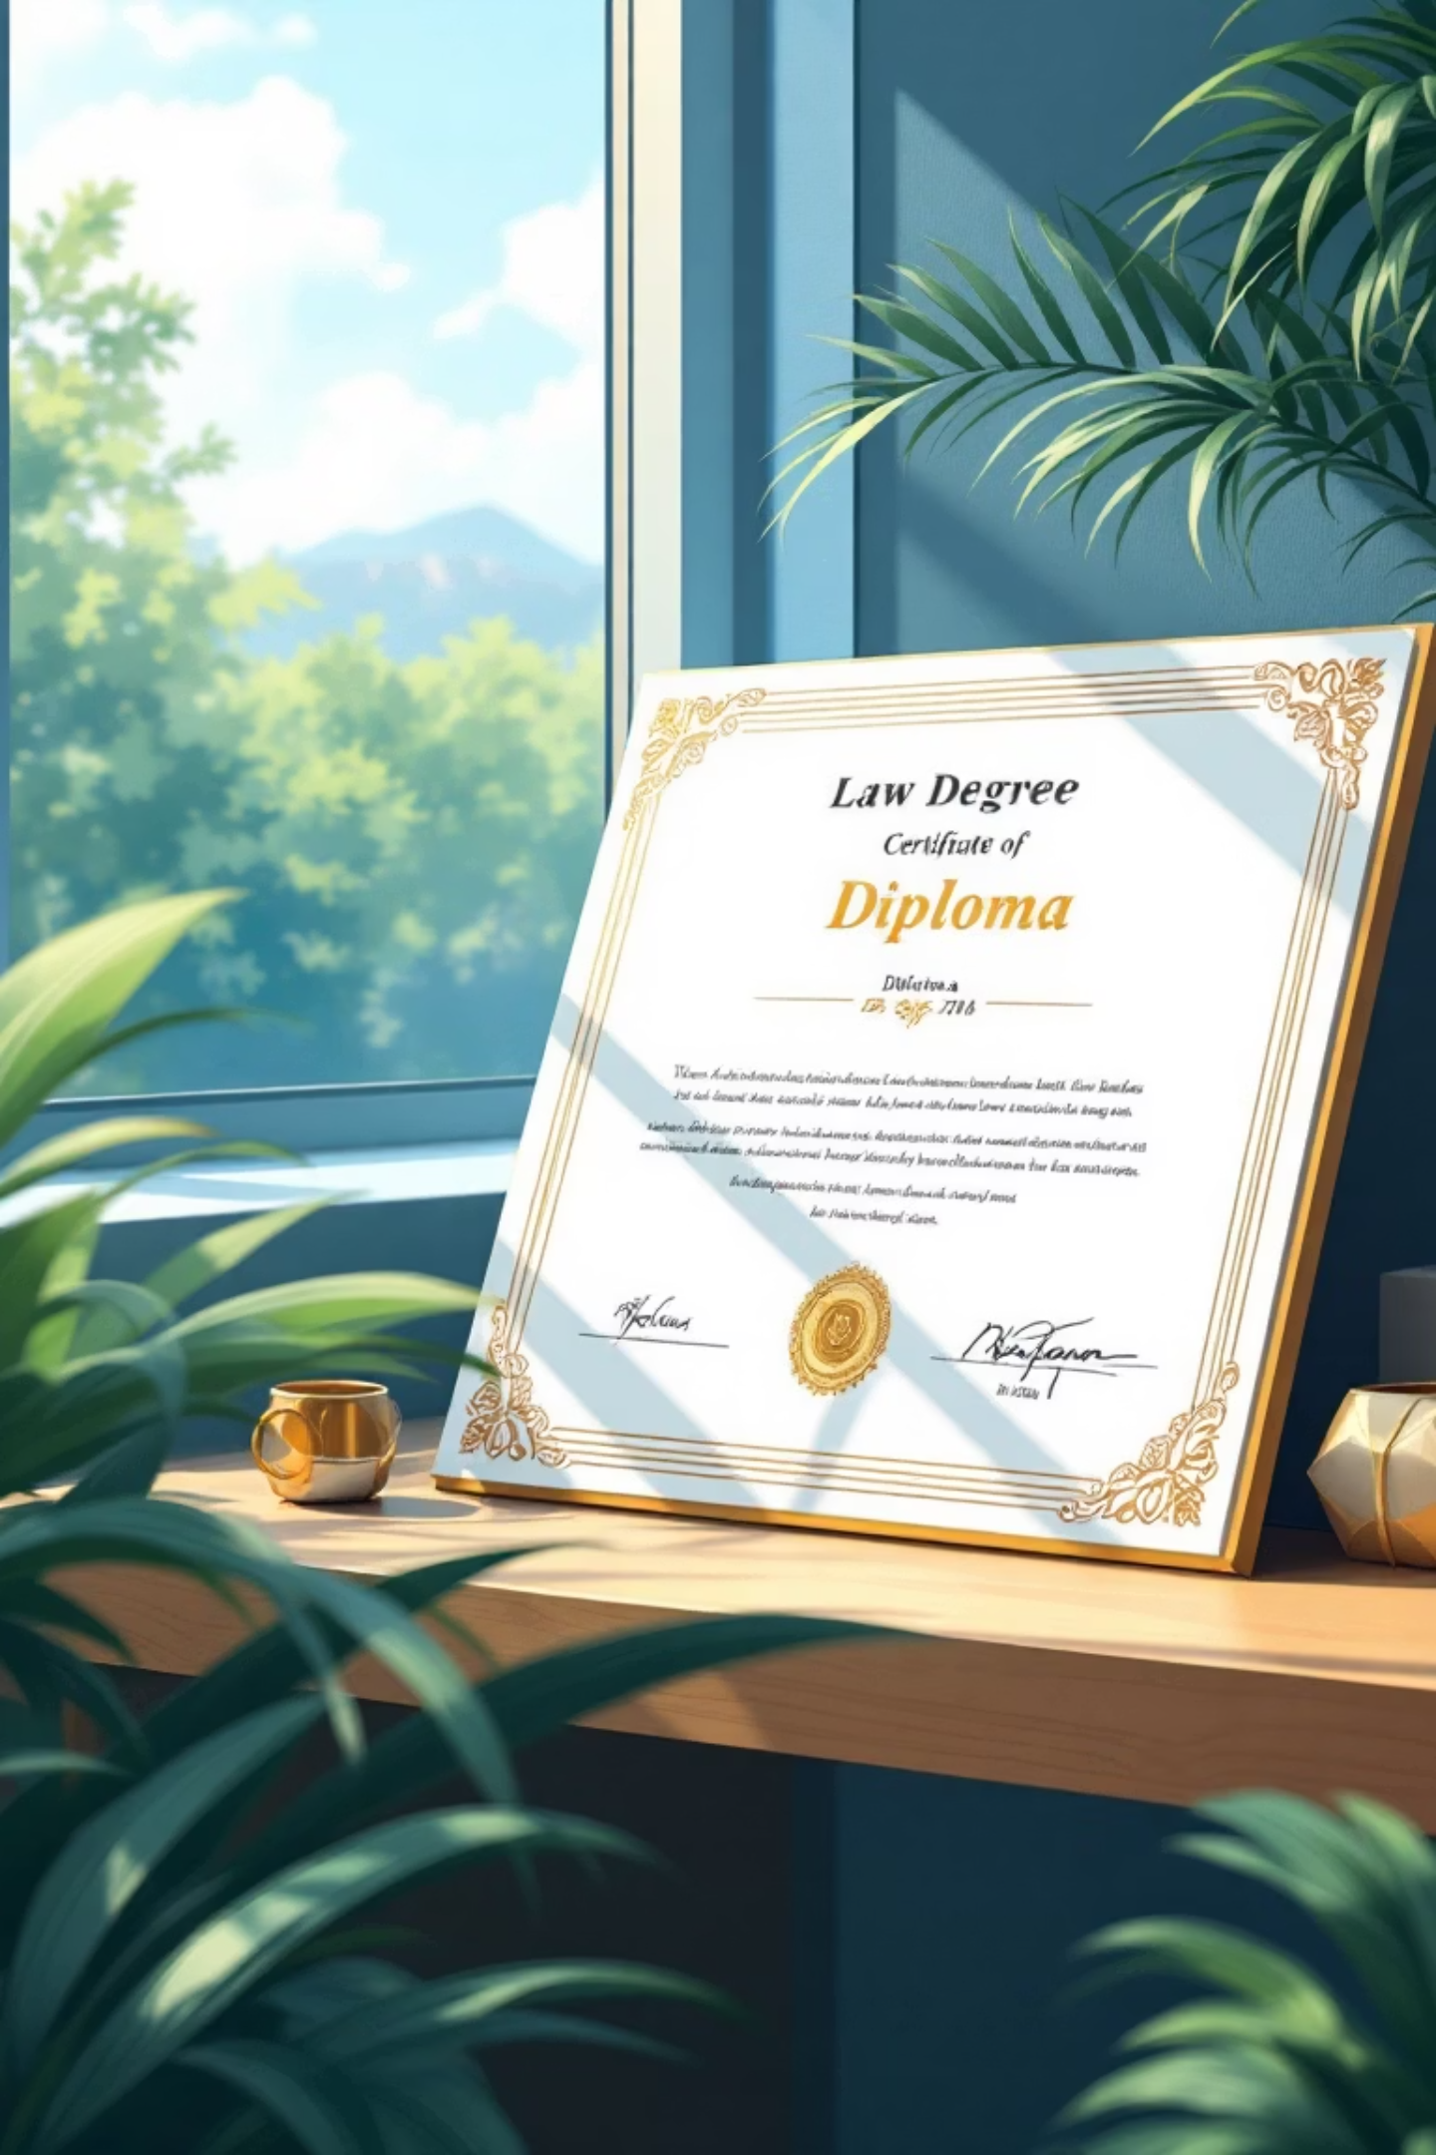
Marking Scheme & Requirements
40%
75%
Minimum Pass Marks
Attendance Requirement
Required in each theory and practical paper for successful completion
Minimum attendance mandatory to be eligible for semester examinations
Assessment Structure: Separate passing criteria for theory and practical components ensures comprehensive evaluation. Internal evaluation contributes to Professional Assessment Score (PAS), providing holistic academic measurement.

Slide 26



Beyond the Curriculum
Diploma Courses
Specialised programmes in Cyber Law, Media & Entertainment Law, Corporate Legal Responsibility, and Intellectual Property Rights for advanced expertise
Mandatory Internships
Practical exposure through required internship programmes and moot court participation for real-world legal experience
Continuous Assessment
Regular internal tests and viva-voce examinations to enhance understanding and develop professional communication skills

Slide 27



Your Legal Career Starts Here
Strategic Location
Prime location in Boisar West with excellent connectivity and accessibility
Expert Faculty
Experienced legal professionals and academics dedicated to your success
Industry-Aligned Curriculum
Comprehensive syllabus perfectly aligned with university standards and
industry requirements
Career-Ready Training
Strong emphasis on practical legal skills and professional development
Build your successful legal career with our solid educational foundation, experienced guidance, and comprehensive practical training!

